Slide 1

Efficient Data Stream Anomaly Detection
Engineer: Mohamed Magdy Diab

Slide 2

Project Objective
The primary goal of this project is to implement a real-time anomaly detection algorithm to identify unusual patterns in a continuous data stream.

Slide 3

The focus is on:
Frist | Second | Third | Fourth
Algorithm Selection | Real-Time Detection | Visualization | Optimization for Speed and Efficiency
SUCCESS

Slide 4


Methodology and Algorithm
We employ the Isolation Forest algorithm, which isolates observations by randomly selecting features and split values. The fewer splits required to isolate a point, the more likely it is an anomaly.
For real-time detection, a sliding window technique is implemented, allowing for dynamic anomaly detection as data is streamed.

Slide 5
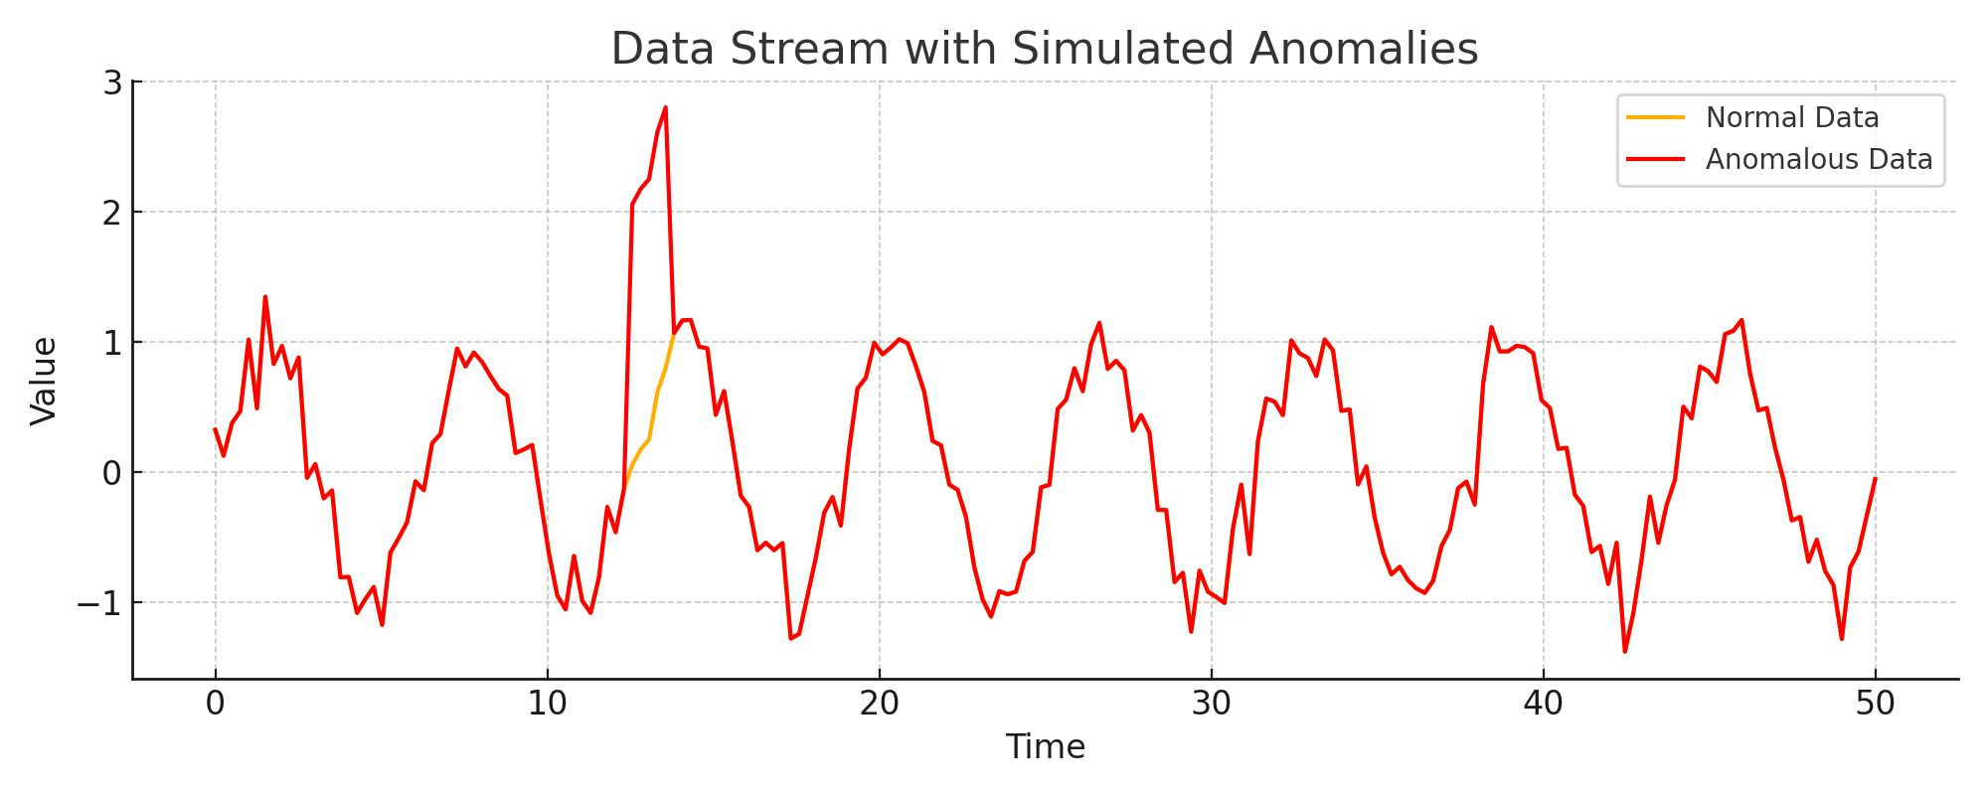
Methodology Visualization
This graph illustrates the simulated data stream. The normal data is represented in blue, while anomalies are shown in red. The algorithm dynamically adjusts and isolates these anomalies based on deviation patterns.

Slide 6
Results
The Isolation Forest algorithm successfully identified anomalies in the data stream. Detected anomalies are shown in red. This method is effective for real-time monitoring and anomaly detection in streaming data applications.

Slide 7
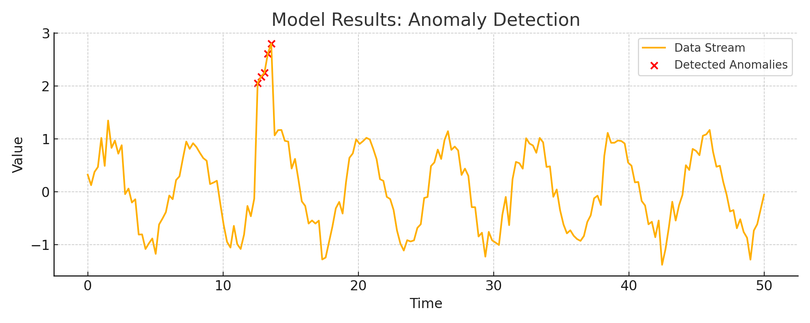
Results Visualization

Slide 8
Conclusion and Future Work
The project successfully demonstrated a real-time anomaly detection model using the Isolation Forest algorithm. Future work includes:
Implementing adaptive learning techniques for concept drift.
Scaling up for larger data streams.
Incorporating more advanced visualization techniques.

Slide 9




THANK YOU!
Mohamed Magdy Diab
mohamedmagdymohameddiab@gmail.com
+201024488395 +201559558806

